Slide 1
The answer is only the beginning
Using one calculation to explore a mathematical concept in depth

Slide 2
This anchor lesson is based around using
‘Show it, draw it, explain it and connect it’
to develop children’s deep conceptual understanding
Show it
Draw it
Explain it
Connect it

Slide 3
This set of slides demonstrates how focussing on one calculation and representing it, explaining it and making connections to it can lead to deep conceptual understanding. This type of anchor lesson is particularly effective at the beginning of a unit of work to provide children with an opportunity to build a visual picture of the structure of the concept and to make connections with other related mathematical concepts.
This anchor lesson has features that can be applied to many mathematical concepts.

Slide 4
This set of slides uses the calculation of
14 x 3 to exemplify the features of an anchor lesson ‘Show it, draw it, explain it, connect it.’
The labels at the top of each slide references where the pedagogy fits in with the priority areas featured in the NCETM calculation guidance.

Slide 5
Correct terminology
Structure
In this anchor lesson you will be expected to use precise vocabulary in full sentences to explain your representations and mathematical thinking. These are key words that you will need to understand and use.
factor
multiplicand
multiplier
product

Slide 6
Todays anchor lesson is based on the calculation
14 x 3
we will …
Show it
Draw it
Explain it
Connect it

Slide 7
Correct terminology
Structure
Conceptual variation
Concrete representations
14 x 3
Show it
Use concrete apparatus to show the structure of multiplication in this calculation. Can you show it in more than one way?
Notes:
Encourage children to represent this calculation with 14 as the multiplicand and 3 as the multiplier, then with 14 as the multiplier and 3 as the multiplicand. Can they show a way to prove that these two calculations have the same product?

Slide 8
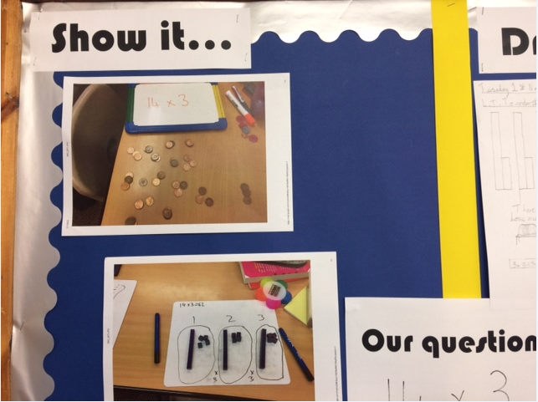

Slide 9
Correct terminology
Structure
Concrete representations
14 x 3
Draw it
Explain it

Slide 10
Precise vocabulary
Structure
Draw a picture of the calculation 14 x 3.
Can you explain your model/picture using precise vocabulary?
Notes:
Can children draw representations using both 14 as the multiplicand and 3 as the multiplicand? Can they annotate their drawings to explain their thinking?

Slide 11
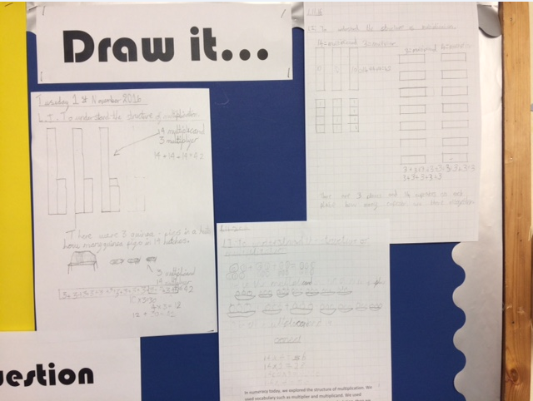

Slide 12
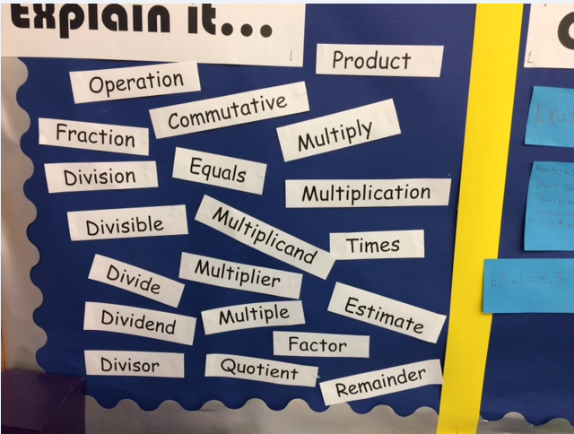

Slide 13
Contextualise the maths
Structure
Tell me a story about your representation
Notes:
In my experience children often find this quite tricky and get muddled up with wording. Use the concrete apparatus models to help to draw out the structure of repeated addition and the idea of the same set of things repeated.

Slide 14
Precise vocabulary
Structure
Express reasoning
Making connections
Change your structure from 3 as the multiplicand to 6 as the multiplicand. How has the multiplier changed?
Can you explain what has happened and why?

Slide 15
Procedural variation
Intelligent practice
Structure
Making connections
14 x 3
Connect it
Notes:
Connections using place value will probably be thought of initially eg. 1.4 x 3 and 14 x 30 etc. Inverse operations will also probably be one of the first connections made eg. 42 ÷ 3 = 14 or 3 = 42 ÷ 14

Slide 16
Procedural variation
Intelligent practice
Structure
Making connections
14 x 3
Connect it
7 x 6
3.5 x 12
1.75 x 24
28 x 1.5
56 x 0.75
Notes:
Using the changed representation of 4 x 3 where 3 is the multiplicand to 6 is the multiplicand, further calculations can be explored using the doubling and halving principle. Can you explain what has happened and why? Can you continue the pattern using this connection of doubling and halving?

Slide 17
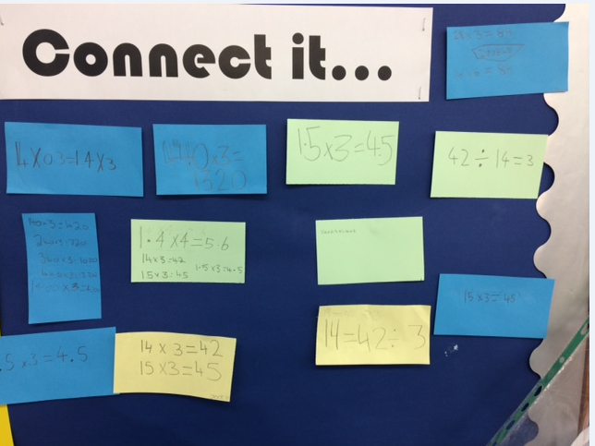

Slide 18
Other ways to encourage reasoning and deep conceptual understanding using one calculation

Slide 19
Use of the equals sign
Structure
14 x ? = 3 x ?
14 + 14 + 14 = 14 x ?
14 x ? = 14 + 14 + 7 + 14 + 7

Slide 20
Use empty box problems
Teach inequality
Procedural variation
Reasoning
14 X 3 > ? X ?
Now can you think of two numbers that will make the product on the right hand side just slightly smaller?
Notes:
Initially this problem is easy without any parameters set. If you ask the children to put in numbers to make the product slightly smaller you get some really great mathematical thinking. Interesting answers to this have been 13.99999 x 3 or 14 x 2.999999 and 27 x 1.5.

Slide 21
Use empty box problems
Teach inequality
Procedural variation
Reasoning
14 X 3 > ? X ?
Now can you think of two numbers that will make the product on the right hand side just slightly bigger?

Slide 22
Precise vocabulary
Structure
Express reasoning
Procedural variation
Change your structure from
14 x 3 where 14 is the multiplicand to 15 x 3. How does this change the product?
Can you explain what has happened and why?

Slide 23
Precise vocabulary
Structure
Express reasoning
Procedural variation
Change your structure from
14 x 3 where 14 is the multiplicand to 14 x 4. How does this change the product?
Can you explain what has happened and why?
Notes:
The Numberlink Board™ is a very useful tool for developing this kind of procedural variation and for visualising the structure of multiplication in its sense of repeated aggregation.

Slide 24
Exposing misconceptions
Identify difficult points
Correct terminology
Structure
Steven says
“When you change 14 x 3 to 15 x 3 the product becomes 1 bigger because 15 is one bigger than 14.”
Is he right – can you explain your thinking?

Slide 25
Procedural variation
Reasoning
Making connections
What is the same and what is different about these two calculations? Can we use the answer from one to work out the other?
14 x 3
14.1 x 3

Slide 26
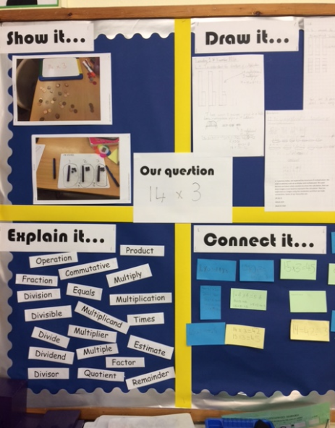

Slide 27
‘People are naturally curious, but we are not naturally good thinkers; unless the cognitive conditions are right, we will avoid thinking.’
Willingham, D.T. (2009) Why Don’t Students Like School?

